Slide 1




B.TECH MAJOR PROJECT PRESENTATION 2020-21
TOPIC: To Minimize the Energy Consumption for Communication Protocol using IOT.
Project ID:21116
National Institute of Science & Technology
By
Name:Suman Priya Sahu
Roll NO:201711357
BPUT Reg NO:1701202262
Name:Manisha Panda
Roll NO:201741413
BPUT Reg NO:1701202078
Under the guidance of:
Mr.Rabindra Kumar Shial
Suman Priya Sahu- CSE/201711357 & Manisha Panda- CSE/ 201741413
[1]

Slide 2
B.TECH MAJOR PROJECT PRESENTATION 2020-21
CONTENT
Objectives
Methodology
Introduction
Outcomes
Stimulation Result
Data Visualisation
Conclusion
National Institute of Science & Technology
Suman Priya Sahu- CSE/201711357 & Manisha Panda- CSE/ 201741413
[2]

Slide 3
B.TECH MAJOR PROJECT PRESENTATION 2020-21
OBJECTIVE
Our goal for this project was to use Advance Technology of Wireless Sensor Network in order to develop, analyze and to reduce the amount of energy and power used by communication protocol in IOT applications.
As per the requirement a proper balance between communication and signal/data processing capabilities should be maintained.
Once we get a good fit ,we will use LEACH Protocol to reduced energy consumption by each network sensor node.
National Institute of Science & Technology
Suman Priya Sahu- CSE/201711357 & Manisha Panda- CSE/ 201741413
[3]

Slide 4
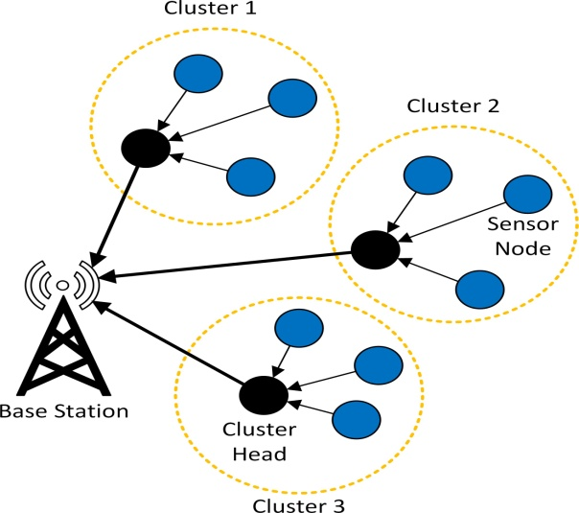
B.TECH MAJOR PROJECT PRESENTATION 2020-21
METHODOLOGY
This is a hierarchical clustering-based routing protocol used for WSN design. In this protocol, cluster heads are changed randomly and one by one some of the nodes become cluster heads. For scalability and robustness, LEACH uses localized coordination for the dynamic network and does data aggregation at the cluster head level. The energy consume from each node will calculated. The project is being implemented in matlab.
LEACH Protocol has two phases:
The Set-up Phase
The Steady-State Phase
The Set-Up Phase where the cluster head are chosen.
The Steady-State Phase where the cluster head is maintained
where the data is transmitted between the nodes.
National Institute of Science & Technology
Suman Priya Sahu- CSE/201711357 & Manisha Panda- CSE/ 201741413
[4]

Slide 5
B.TECH MAJOR PROJECT PRESENTATION 2020-21
INTRODUCTION
WSN is a technology used within an IOT system. As IOT exists at a higher level then WSN.
A large collection of sensors, as in a network, can be used to individually gather data and send data through a router to the internet in an IOT system.
An IOT system can utilize a wireless sensor network by communicating with its router to gather data. In IOT, many physical objects are attached to convert the information while using the Internet.
Moreover, the technology of Wireless sensor networks (WSNs), which are associated with IOT, represent useful networks in the monitoring, tracking and sensing different environmental activities and the sensors characteristics play the main role in designing and applying any WSN.
National Institute of Science & Technology
Suman Priya Sahu- CSE/201711357 & Manisha Panda- CSE/ 201741413
[5]

Slide 6
B.TECH MAJOR PROJECT PRESENTATION 2020-21
OUTCOMES
Deployment of the nodes.
Calculation of the distance among the nodes.
Creating Cluster.
Threshold for Cluster Selection.
Maintaining the power level of the node.
Calculation of the energy consume and network performance by each node.
National Institute of Science & Technology
Suman Priya Sahu- CSE/201711357 & Manisha Panda- CSE/ 201741413
[6]

Slide 7
B.TECH MAJOR PROJECT PRESENTATION 2020-21
SIMULATION RESULTS
Parameters
Simulation area
Number of nodes
Base Station coordinates
Initial Energy
Probability to the node to become a CH
Energy for transferring of each bit of data
Energy for receiving of each bit of data
Energy for free space model
Energy for multipath model
Energy for data aggregation
Values
100 X 100 m
100
(50,50)
0.5
0.1
50*0.000000001
50*0.000000001
10*0.000000000001
10*0.000000000001
5*0.000000001
National Institute of Science & Technology
Suman Priya Sahu- CSE/201711357 & Manisha Panda- CSE/ 201741413
[7]

Slide 8
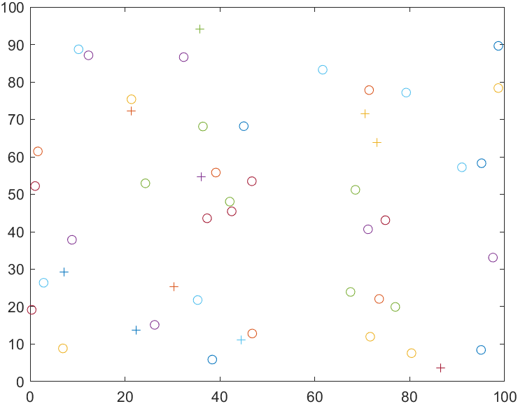
B.TECH MAJOR PROJECT PRESENTATION 2020-21
Data Visualisation
Deployment of Nodes
National Institute of Science & Technology
Suman Priya Sahu- CSE/201711357 & Manisha Panda- CSE/ 201741413
[8]

Slide 9
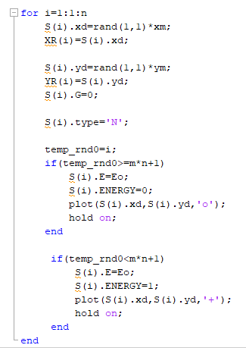

B.TECH MAJOR PROJECT PRESENTATION 2020-21
National Institute of Science & Technology
Selection of cluster head is calculated using this equation:-
temp_rnd<=(p/1-p [ mod(r, 1/p) ] ) where nodes belongs to G
Otherwise 0
Suman Priya Sahu- CSE/201711357 & Manisha Panda- CSE/ 201741413
[9]

Slide 10
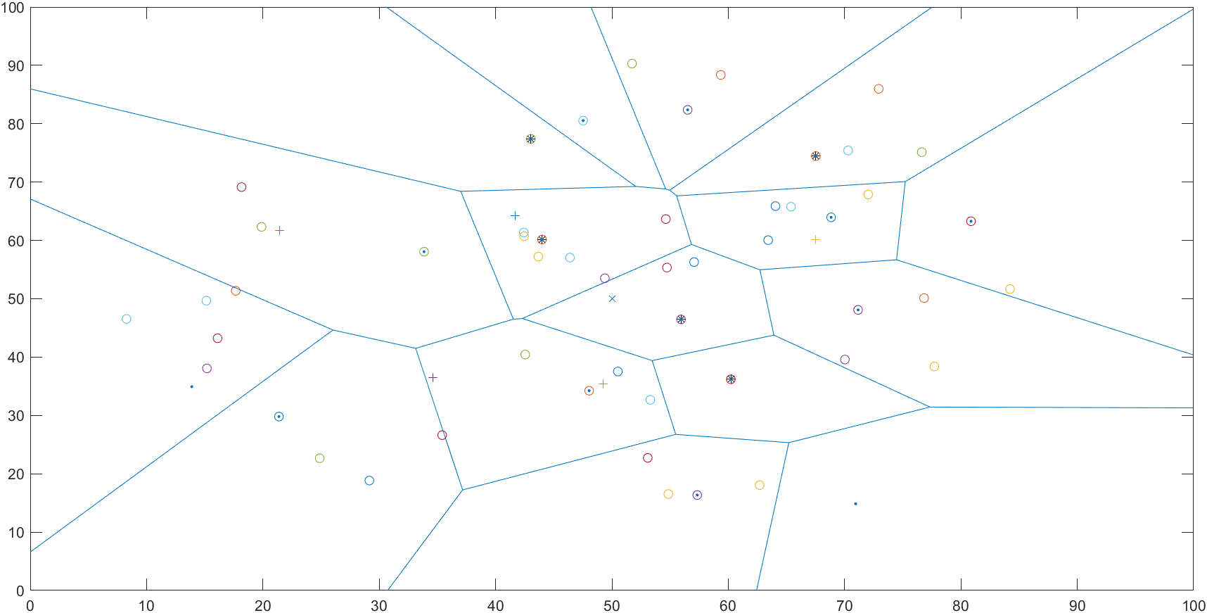
B.TECH MAJOR PROJECT PRESENTATION 2020-21
Cluster Formation and Cluster Head Selection
National Institute of Science & Technology
Suman Priya Sahu- CSE/201711357 & Manisha Panda- CSE/ 201741413
[10]

Slide 11
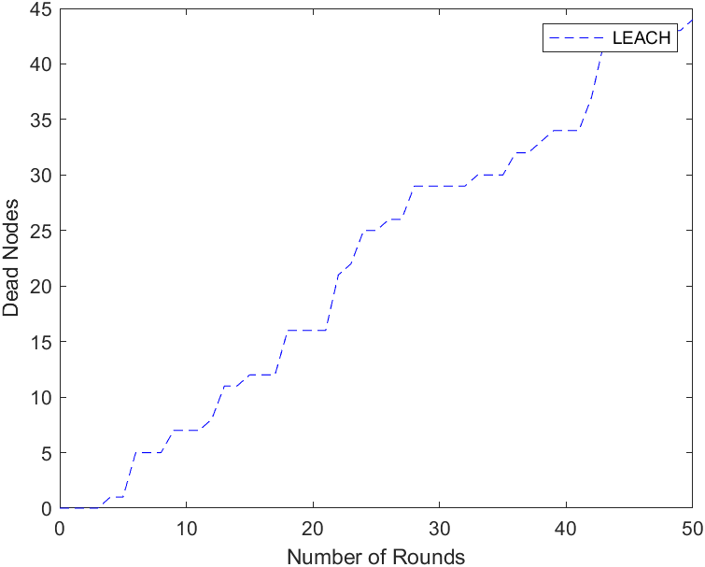
B.TECH MAJOR PROJECT PRESENTATION 2020-21
Power Level of Nodes
National Institute of Science & Technology
Suman Priya Sahu- CSE/201711357 & Manisha Panda- CSE/ 201741413
[11]

Slide 12
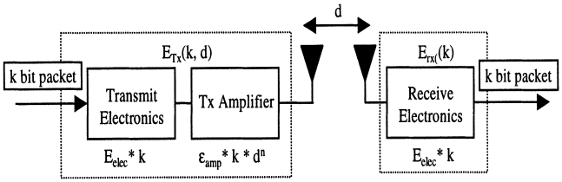
B.TECH MAJOR PROJECT PRESENTATION 2020-21
The amount of transmitted data and the total quantity of data sent from the nodes in the WSN to base station calculated by:
Data =dataCHtoBS + dataNtoBS,
National Institute of Science & Technology
Energy dissipated in data transmission is being estimated by:-
𝐸𝑇𝑋= {𝑘 ∗ 𝐸elect + 𝑘 ∗ 𝜀fs ∗ 𝑑^2 if 𝑑 ≤ 𝑑𝑜,
𝑘 ∗ 𝐸elect + 𝑘 ∗ 𝜀mp ∗ 𝑑^4 if 𝑑≥do,
Energy dissipation while reception is:-
𝐸𝑅𝑋= 𝑘 ∗ 𝐸elec.
Suman Priya Sahu- CSE/201711357 & Manisha Panda- CSE/ 201741413
[12]

Slide 13
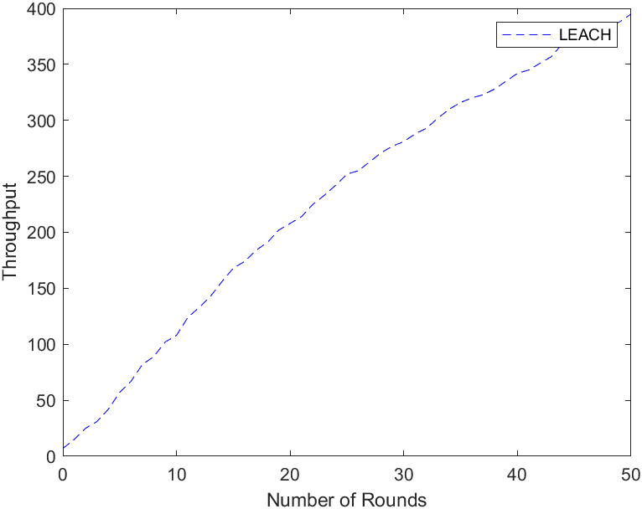
B.TECH MAJOR PROJECT PRESENTATION 2020-21
Packets sent to the base station
National Institute of Science & Technology
Suman Priya Sahu- CSE/201711357 & Manisha Panda- CSE/ 201741413
[13]

Slide 14
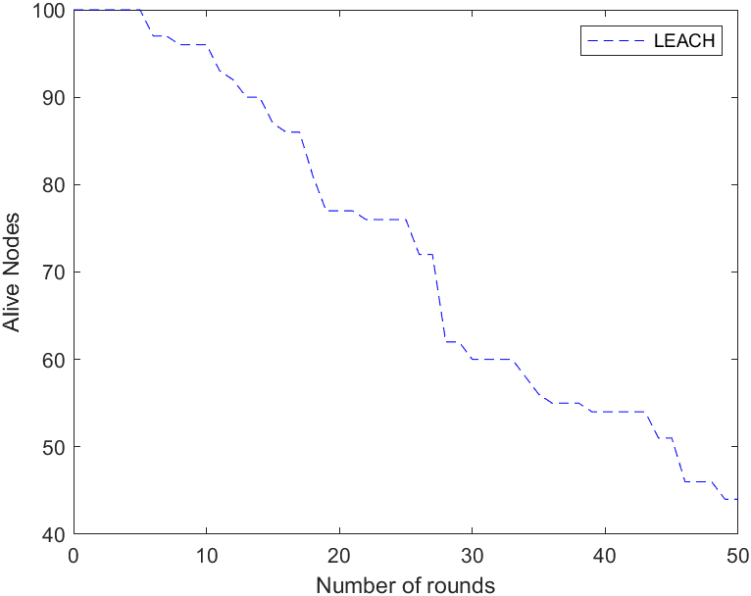
B.TECH MAJOR PROJECT PRESENTATION 2020-21
Network Performance Graph using LEACH
National Institute of Science & Technology
Suman Priya Sahu- CSE/201711357 & Manisha Panda- CSE/ 201741413
[14]

Slide 15
B.TECH MAJOR PROJECT PRESENTATION 2020-21
CONCLUSION
We have used a approach to promote highly effective communication protocol. By this energy efficient protocols, it is found that the proposed algorithm performs better in terms of stability period and network lifetime in different scenarios of area, energy and node density.
National Institute of Science & Technology
Suman Priya Sahu- CSE/201711357 & Manisha Panda- CSE/ 201741413
[15]

Slide 16
B.TECH MAJOR PROJECT PRESENTATION 2020-21
REFERENCE
R.P. Mahapatra and R.K. Yadav, "Descendant of LEACH based routing protocols in wireless sensor networks", Procedia Comput. Sci., vol. 57, pp. 1005-1014, 2015.
L. Yadav and C. Sunitha, "Low energy adaptive clustering hierarchy in wireless sensor network (LEACH)", Int. J. Comput. Sci. Inf. Technol., vol. 5, no. 3, pp. 4661-4664, 2014.
National Institute of Science & Technology
Suman Priya Sahu- CSE/201711357 & Manisha Panda- CSE/ 201741413
[16]

Slide 17
B.TECH MAJOR PROJECT PRESENTATION 2020-21
THANK YOU
National Institute of Science & Technology
Suman Priya Sahu- CSE/201711357 & Manisha Panda- CSE/ 201741413
[17]

